Slide 1
What will you do when you leave school?

Slide 2
will take you on
your career planning journey!
This program will help you to find jobs which are suitable for you. It will also provide reports including personal profile information, pros and cons of different jobs for you, and lots of other useful stuff.
Knowing where your career is heading makes subject choice and post-school training options easier and more rational.
Based on eighty job factors (including working conditions, health, talents, etc.) the system will generate twenty job suggestions for you. You can then explore related job information, add jobs to your Notepad, look at similar jobs, start your Action Plan and Resume.

Slide 3
Accessing Career Voyage
Just go to the following website with any PC, Apple, or tablet:
www.jiig-cal.com.au, mouse over LOG IN, and click on Career Voyage for your country
or
www.careervoyage.com.au/au/ (Australia)
www.careervoyage.com.au/nz/ (New Zealand)

Slide 4
1. Student log in
Temporary Accounts
The same number for username and password
Self signup
Check with your career adviser
OR

Slide 5
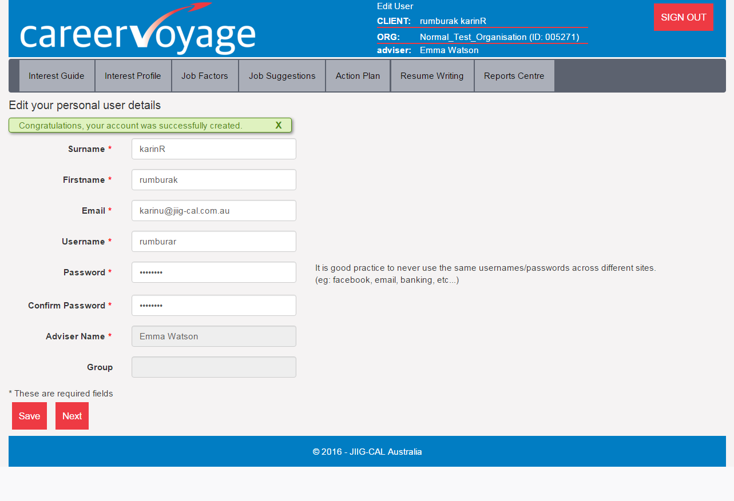
2. Edit your personal user details
Enter your personal details
Create your username and password (at least 6 characters)
Choose your advisor and group.
NB: For temporary accounts the adviser and the group have been already set up.

Slide 6
Career Voyage Survey
Your responses to the survey questions will be used purely for research purposes and has no impact on Career Voyage outcomes.

Slide 7
The Right Mindset
Before you start, read carefully Ergo’s Introduction how to work with responses from Strong Dislike to Strong Like.

Slide 8
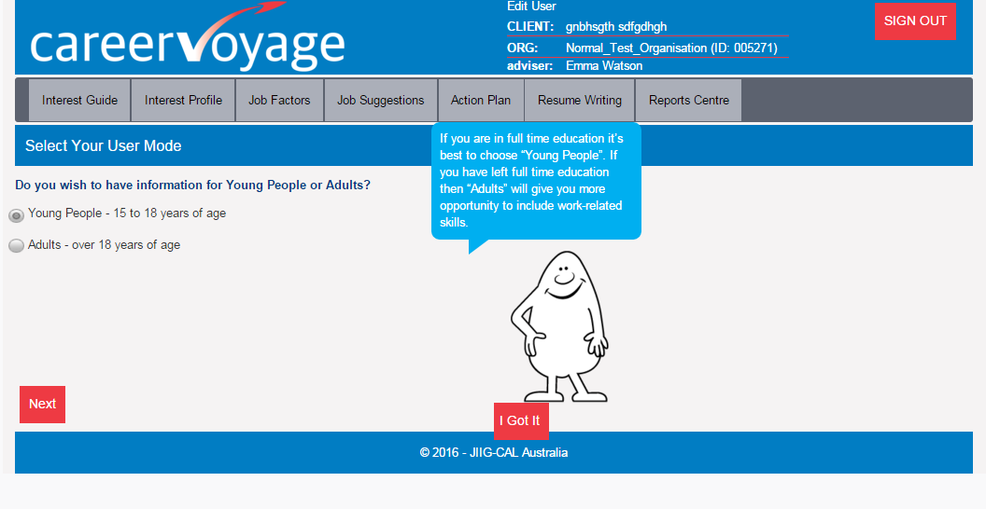
3. Select your age group

Slide 9
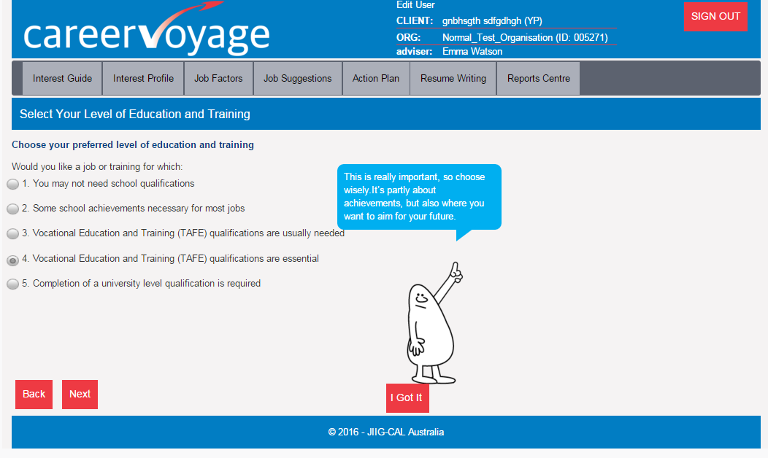
4. Choose the Level you would LIKE to get
Your eventual Job Suggestions will relate to the Level you choose here. So please take a few moments to think and choose wisely.
If for example you want to go to university after you finish school, choose level 5. If you want to go to TAFE and do a course, chose level 3 or 4. If you want to leave school and get a job straight away with very minimal training, choose level 1.

Slide 10
5. The Occupational Interest Guide
Go through each question clicking on how much you might like to do that activity, until you have gone through all the pages.
All jobs have a mixture of things you like, things you don’t mind and things you dislike. The job with everything you like and nothing you dislike probably does not exist. The key to job satisfaction is the best balance. Ideally you want to find a job with more of the things you like and less of the things you dislike.
Your chance of finding a fulfilling job depends a lot on your attitude. If you like a lot of things, you have a better chance of finding a job you like. If you dislike a lot of things, you have less chance of finding a satisfying job.
Not try to “make” the software give you a particular job or result. Answer honestly.
There is no need to analyse each task: take each one at face value and answer based only on the information in front of you. If unsure how to respond, your initial reaction is usually the most accurate.
This should be an enjoyable experience. You can enjoy the process and take it seriously at the same time.

Slide 11
6. Your Interest Profile
Click Interest Types for descriptions
Once you have completed the interest guide, your personal Interest Profile will come up.
You should discuss this with your teacher/adviser before proceeding to the next stage, particularly if you think the result is not quite right for you.

Slide 12
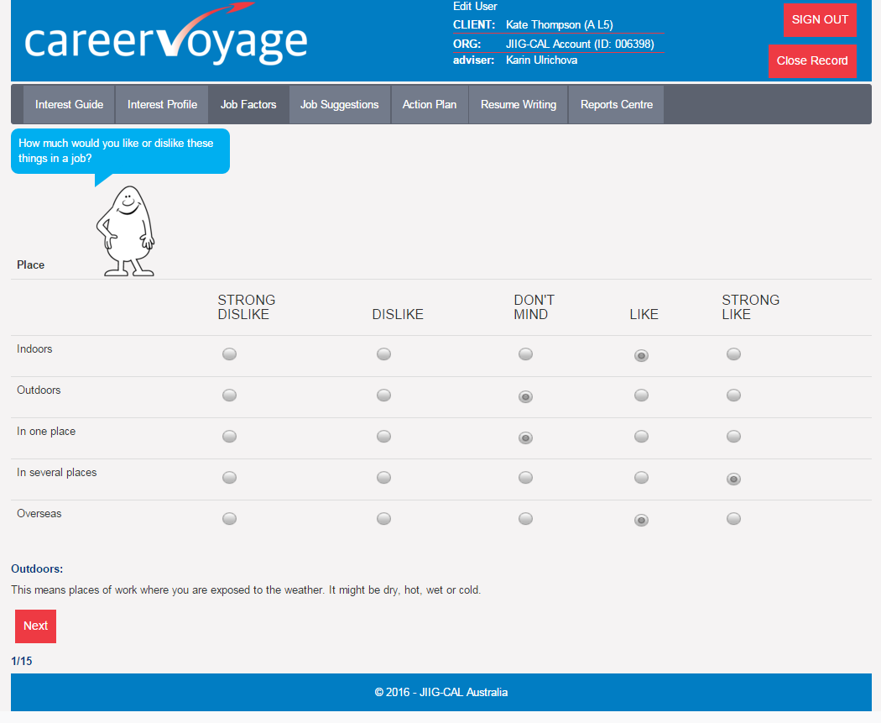
7. Go through Job Factors
Mouse over the rows and read the descriptions

Slide 13
8. Your Job Suggestions
20 or 40 job suggestions for you, based on what you have said about yourself.
When you click on a job on the left side of the screen, information about it will come up in the box on the right side. If you think a job sounds like something you would like to save, you can add it to your Notepad.

Slide 14
9. Exploring Your Job Suggestions
Clicking on the “pros & cons” button for the chosen job will show the things which fit in with what you said about yourself, and the things which don’t.
You can also find Similar Jobs, explore Other Jobs not on your list of 20, and can view your Notepad. So spend some time exploring here. You can also come back at any time using your secure Username and Password.

Slide 15
10. Action Plan – Learning Strategies
Most students (including students of the world) are keen to work smarter rather than harder. The new Learning Strategies gives insightful hints and tips to achieve this.

Slide 16
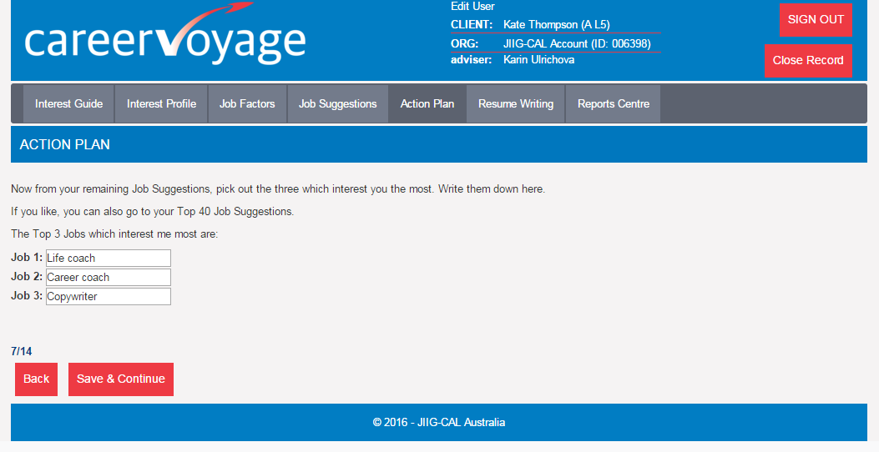
10. Your Action Plan
Once you have some career goals in mind, developing an Action Plan will help you to get there. It’s like putting in place stepping stones leading to your destination. If you don’t do it right now, you should come back and do it soon. And don’t forget to keep working on it over time.

Slide 17
11. Résumé Writing
It’s never too early to start a personal résumé. And you’ll never stop developing it.
When you start looking for jobs you’ll need one, and it’s much easier to start now than leave it to later.
This section of Career Voyage will help you to develop a winning résumé.

Slide 18
12. Report Centre
Click the Reports Centre tab to create PDF reports on all the things you have done so far. You can save these, email them, print them off to discuss with people important to you. You may also want to research some jobs on the Internet.

Slide 19
Over to you!
That’s an overview.
Now you’re ready to develop your very own career plans.
Good luck and thanks for using Career Voyage.

